Slide 1


Slide 2

COMPANY PURPOSE
Online Party Kit
It is an opportunity for a user to organize and promote a party easily and quickly. Just choose the right scenario, make a fascinating description and attach a banner, pick up vendors (venue, artists, DJs, animators, decorators, photographers, catering, etc.), publish the event, then invite guests. Those who like to have fun will be able to find a suitable party with electrifying and friendly atmosphere.

Slide 3
PROBLEM
MONEY
By consulting an event planning agency to organize a party you overpay about 40%
COMMUNICATION
People began to communicate online more than in real life
MARKETING
Talented event industry vendors have to spend much time looking for clients

Slide 4
SOLUTION
Use Cockktail platform to:
SAVE MONEY
EARN MONEY
ENJOY YOUR NEW
ACQUAINTANCES
SHOW YOUR
INDIVIDUALITY
+1 MORE REASON
FOR A GOOD MOOD
And make your party awesome!!!

Slide 5







PRODUCT
Cockktail is a marketplace where party makers find vendors
3%
Party makers
Clubbers
Vendors
specify party details select vendors and chat with them publish the party send invitations/sell tickets enjoy the party! | define location choose the party with best music and atmosphere for you join the party and have fun! | fill your profile get orders from the party makers or submit a bid make money!
Current stage: MVP

Slide 6

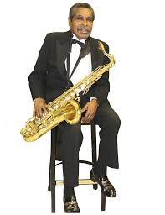
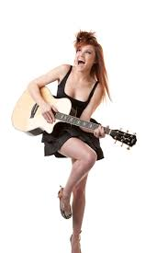


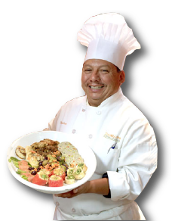


CLIENTS CATEGORIES
3party hosts (people who organize parties)
vendors
(musicians, djs,
entertainers,
catering, etc.)
clubbers
(people who attend parties)

Slide 7
EVENT CATEGORIES
birthday parties
private parties (disco parties, BBQs, pool parties, etc.)
theme parties (Halloween, western or rock stars parties, etc.)
university/college parties
celebrations (bar/bat mitzvahs, sweet 16 parties, etc.)
public events (concerts, music festivals, carnivals, etc.)

Slide 8






BUSINESS MODEL
7%
service fee
party hosts
3%
service fee
vendors
clubbers
The project will keep the commission of 7% of the cost of services provided by vendors
From ticket sales to public parties 3% service fee will be charged
Additional sources of profit are being considered (lifting vendors up on the list, selected ads, etc.)

Slide 9
MARKET SIZE
>$100B
PAM (Potential Available Market)
TAM (Total Addressable Market)
$34B
$7B
SAM (Served Available Market)
SOM (Serviceable & Obtainable Market)
$3.5M

Slide 10





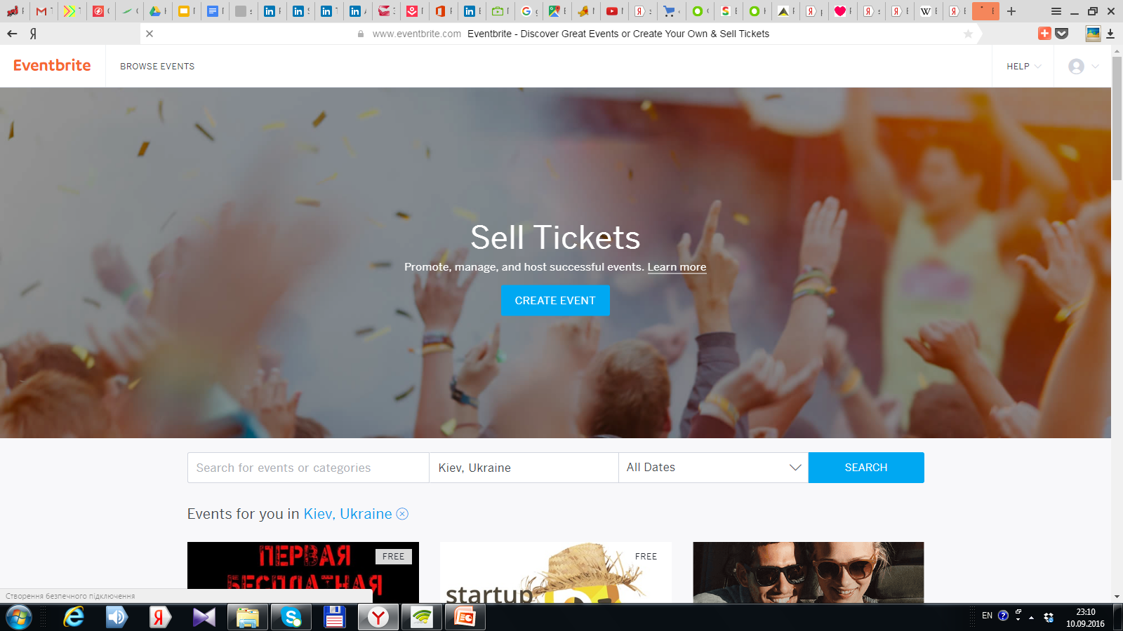



Competitors
Services | Kit | Smart search of orders for vendors | Guest list | Vendors | Public Parties List | Automatic selection of relevant vendors | Guest Chat | Promo tools | Photo report

Slide 11
OUR COMPETITIVE ADVANTAGES
Smart search system of vendors and orders for vendors
Save money. Organizer works with the vendor directly, without intermediaries
Enjoy. Find a cool event and have fun while surrounded by like-minded people
Earn money. Source of income for vendors
Promo tools. You will be able to attract a specific target audience in the necessary quantity
Make fun. Your friends will be amazed by your creative abilities
Party`s Ideas. In the collection of scenarios on our site you`ll find a lot of additional ideas

Slide 12
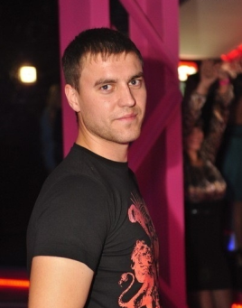
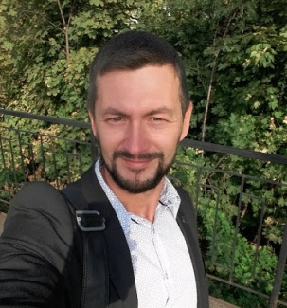
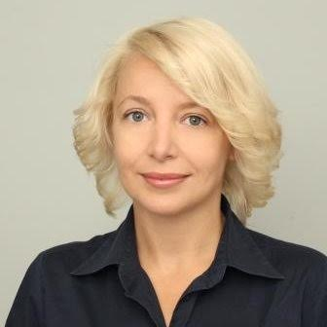
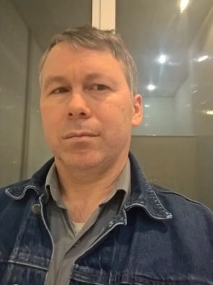
TEAM
Vadim Matviichuk CEO In past - editor in chief of Geometria.ru (show biz project) organized over 200 events of different types +38 (068) 581 58 61 vadim@cockktail.com | Vasyl Kozmin CFO 1C developer, business consulting and business automatization, experience in direct sales +38 (050) 935 27 30 vasyl@cockktail.com | Anna Potri Management & PR In past – deputy director of Legal Affairs. Marketing, personnel management. Legal registration and tracking of business +38(063)593 42 35 potri@cockktail.com
Leonid Martynyuk
CTO
Senior PHP/NET/Fullstack developer
Integrated solutions using IoT/sensor technology and proprietary software to optimise asset management and tracking within supply chains
+38 (097) 370 70 47
leon@cockktail.com

Slide 13
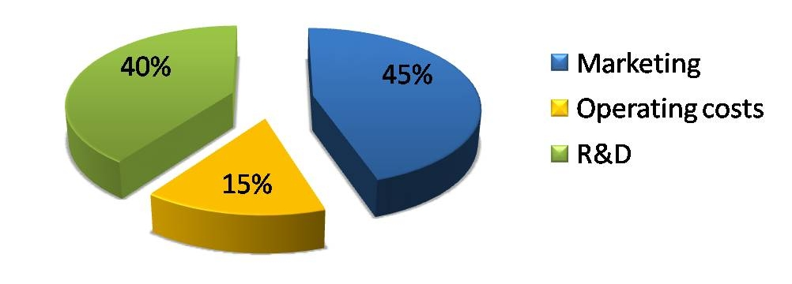
FINANCIALS
The initial investment requirement of $ 380K
Expenses:

